Slide 1
July 6-10
Re-queried the database
Explored pandas python package to query fits table from Topcat
Improved the efficiency of the previous algorithm using pandas
Calculated errors from error propagation for MCMC – not finished yet

Slide 2
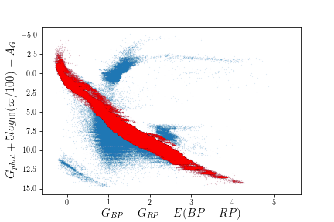
H-R diagram
Parallax > 2
Parallax_error/parallax<0.1
phot_bp_mean_flux_over_error > 10
phot_rp_mean_flux_over_error > 10
Total sample count: 12899067
Main sequence stars count: 6158038

Slide 3
Subgroup#1:

Slide 4
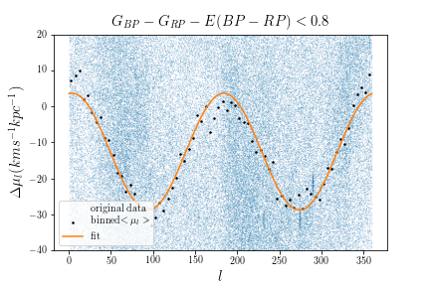
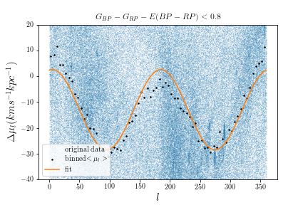
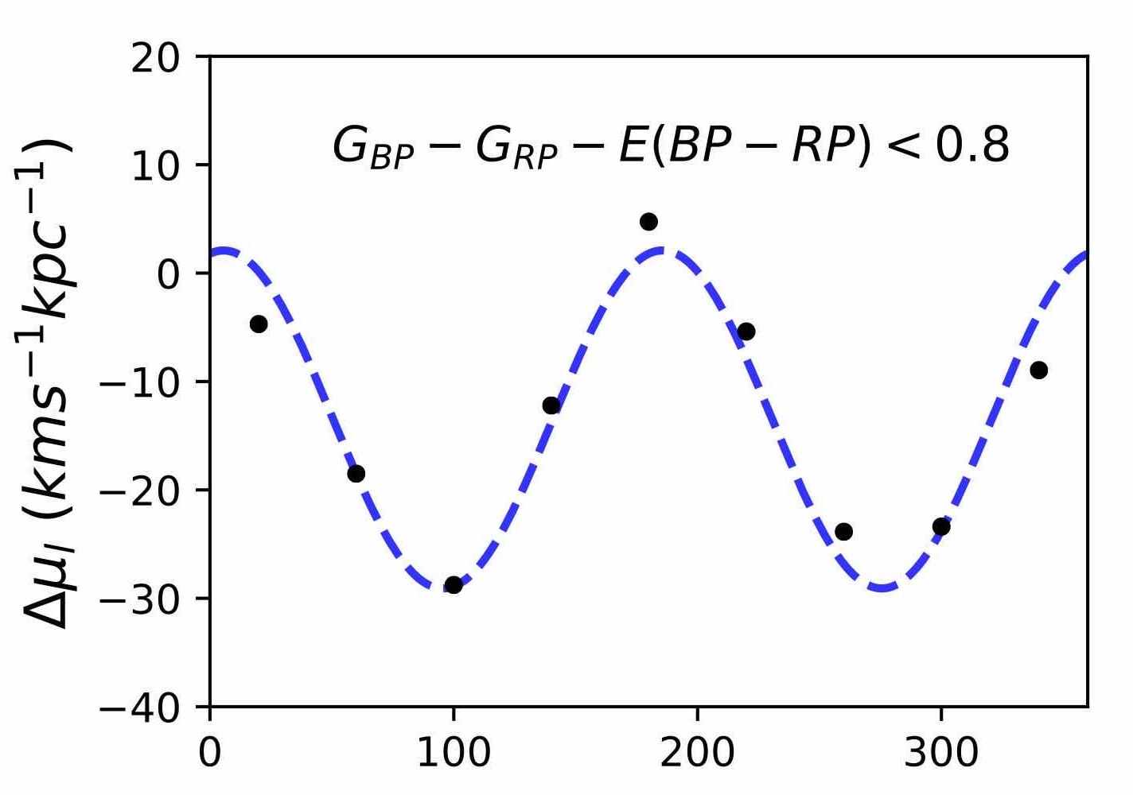
Previous result:
Sample size: 306,872
A=16.08
B =-12.60
C= -2.29
Li:
A= 15.3 +/- 0.2, B=-13.5+/-0.2,
C=-3.0+/-0.2
Sample size: 454,025
A: 15.31 B: -12.97 C: -2.68

Slide 5
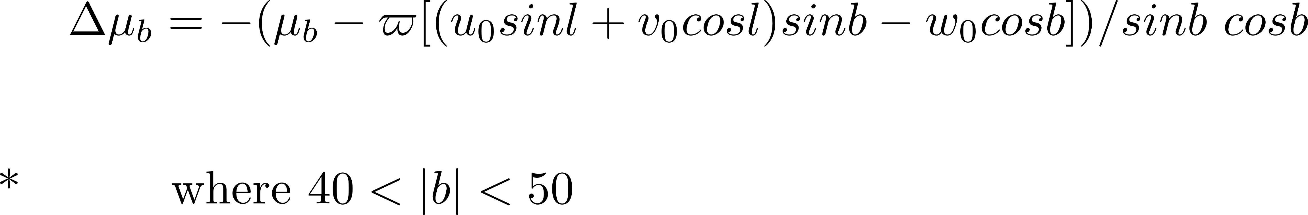
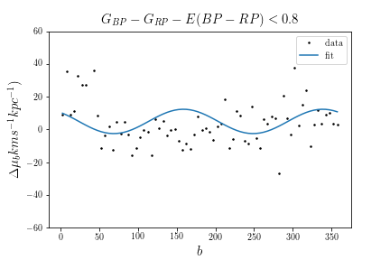
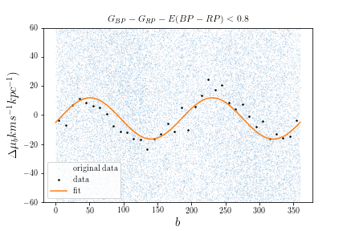
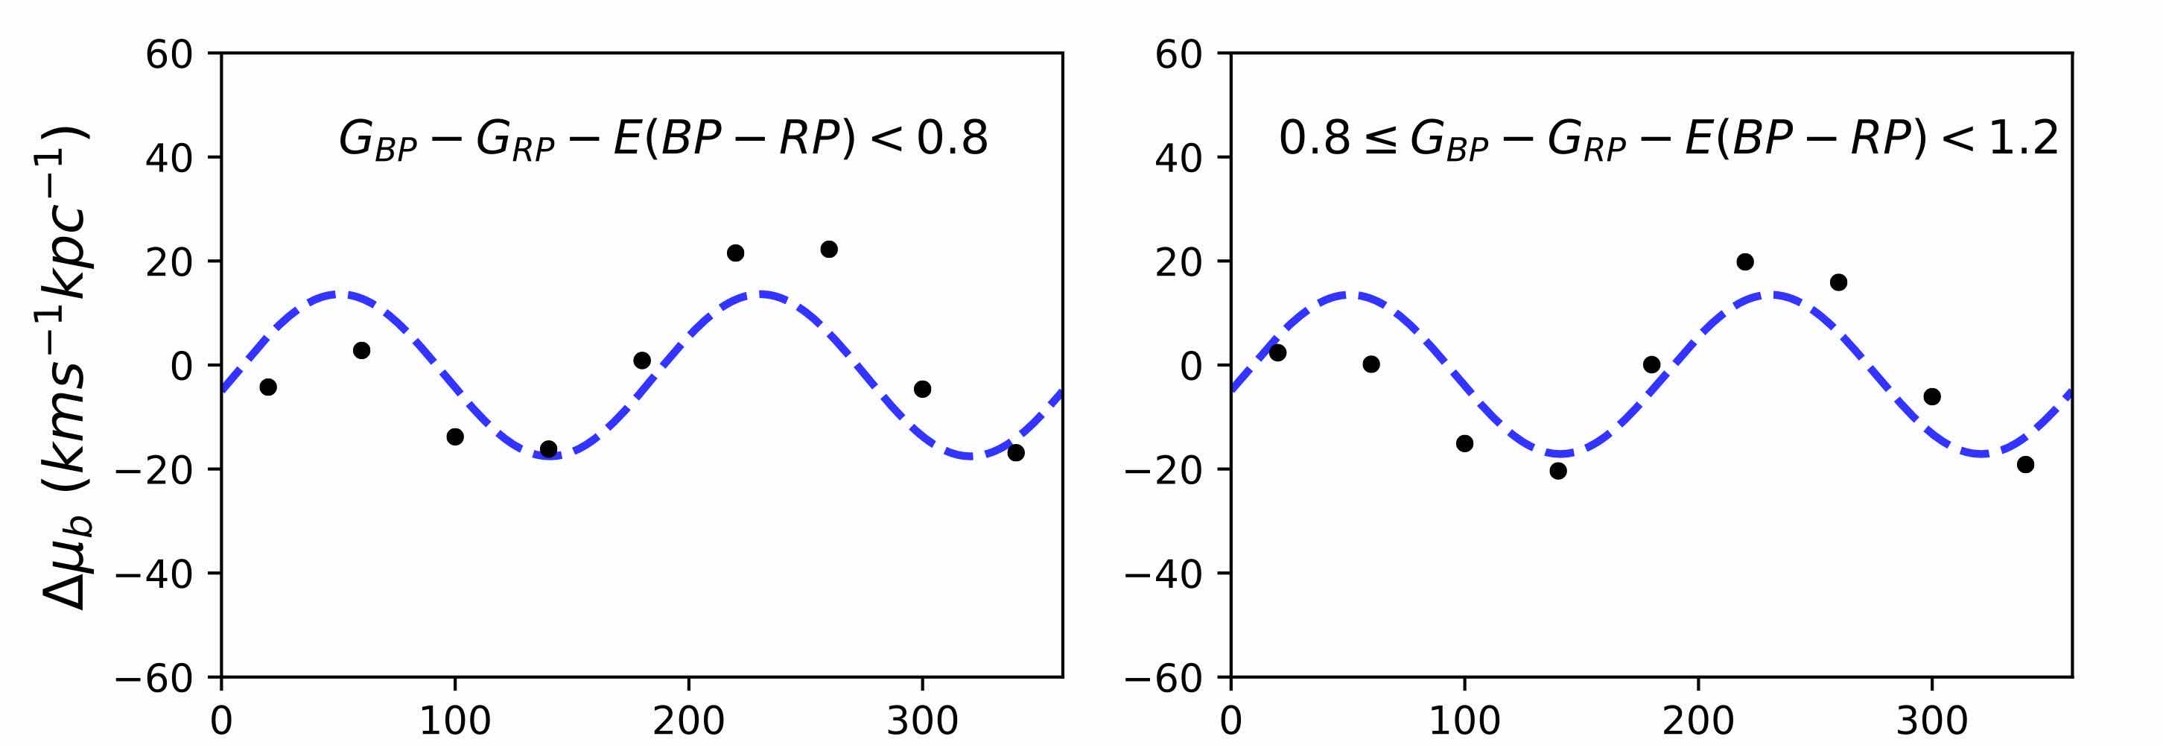
Previous result:
Sample size :
139,067
A=5.46, C=-4.85,
K=5.04
From Li, 2019
A=15.31+/-0.2,
C=-3.0 +/- 0.2
K=-2.0+/-0.3
Sample size: 93,293
A: 13.91 C: -2.78 K: -2.42

Slide 6
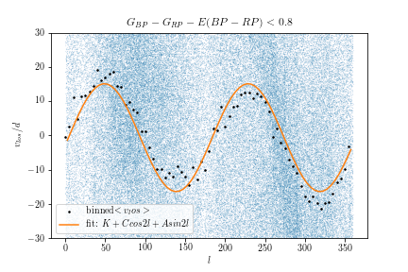
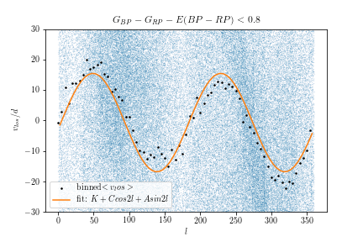
Sample size: 300,078
A: 15.31 C: -2.14 C: -0.68
Previous result:
Sample size: 306,872
A: 16.01 C: -2.20 K: -0.72

Slide 7
Subgroup#2:

Slide 8
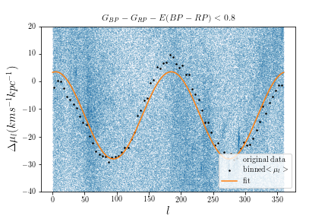
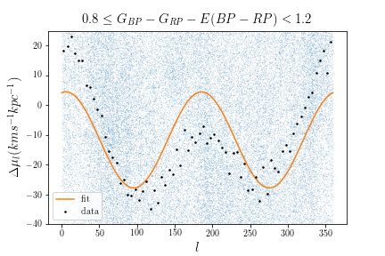
Previous result:
Sample size: 189,037
A=15.84
B =-11.7
C= -3.16
Li:
A= 15.0 +/- 0.2,
B=-13.6+/-0.1,
C=-3.1+/-0.2
Sample size: 739,786
A: 15.31 B: -12.97 C: -2.68

Slide 9
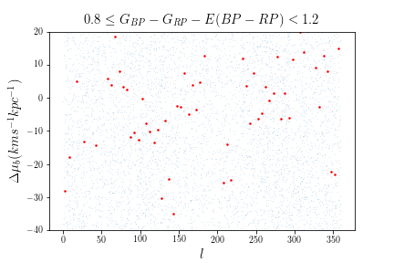
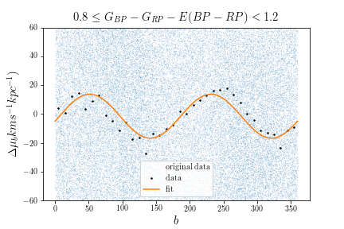
Previous result:
Too few samples
Larger samples give a better result
From Li, 2019
A=15.0+/-0.2,
C=-3.1 +/- 0.2
K=-1.8+/-0.3
Sample size: 158,955
A: 14.89 C: -3.40 K: -1.58

Slide 10
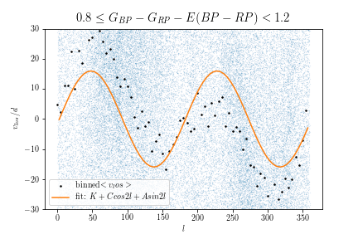
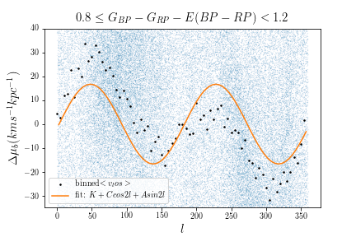
V_los: deviates from the predicted behavior based on the assumption of circular motion
Previous result:
Sample size: 189,037
A: 16.01 C: -2.20 K: -0.72
Sample size: 158,955
A: 15.88 C: -1.59 K: -0.03
From Li, 2019: A=15.0+/-0.2, C=-3.1 +/- 0.2 and K=-1.8+/-0.3

Slide 12
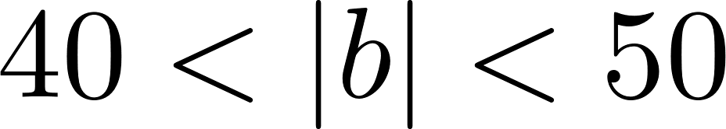
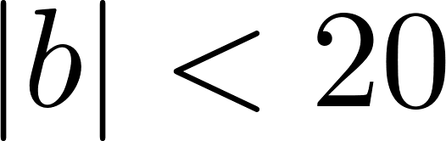
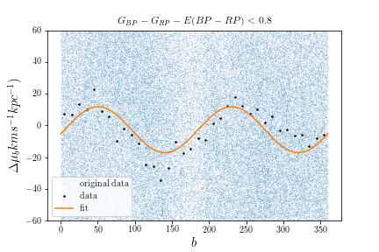
Sample size: 93,293
A: 13.91 C: -2.78 K: -2.42
Sample size: 276,354
A: 14.25 C: -2.65 K: -2.72
From Li, 2019: for this subgroup: A=15.31+/-0.2, C=-3.0 +/- 0.2 and K=-2.0+/-0.3

Slide 13
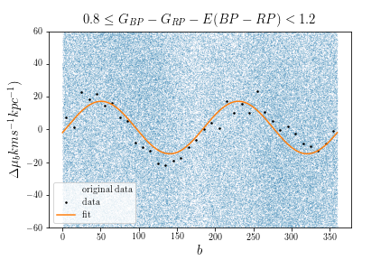
Sample size: 158,955
A: 13.91 C: -2.78 K: -2.42
Sample size: 469,719
A: 16.14 C: -3.19 K: -3.47
From Li, 2019: for this subgroup: A=15.0+/-0.2, C=-3.1+/- 0.2 and K=-1.8+/-0.3

Slide 14

Why did Li select 40<|b|<50 in analyzing
I don’t know…
Selecting |b|<20 also yields good result and has a lager sample number for both subgroups.

Slide 15
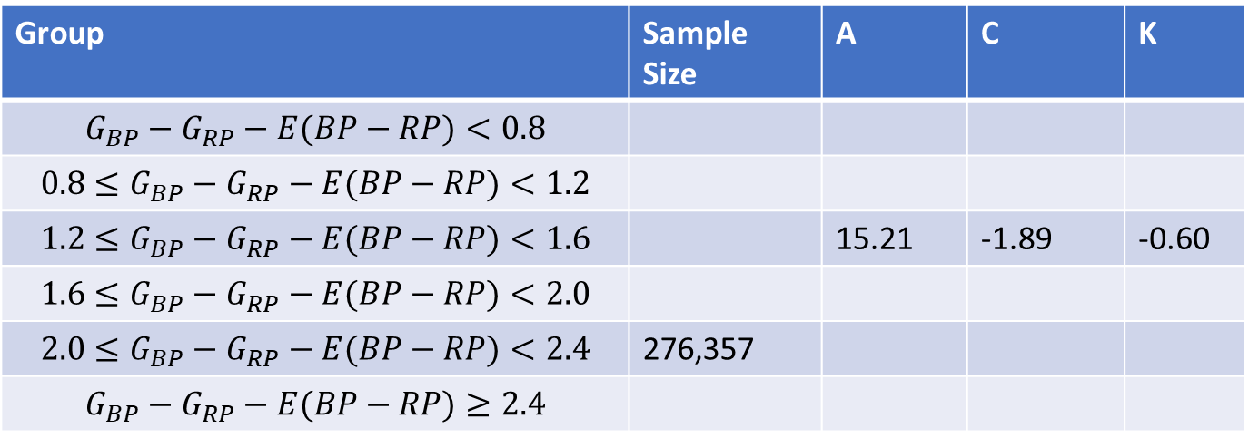

$$μ_{b ,}\left|b\right|<20$$
Group | Sample Size | A | C | K
$$G_{BP}−G_{RP}−E(BP−RP)<0.8$$
$$0.8≤G_{BP}−G_{RP}−E(BP−RP)<1.2$$
$$1.2≤G_{BP}−G_{RP}−E(BP−RP)<1.6$$ |  | 15.21 | -1.89 | -0.60
$$1.6≤G_{BP}−G_{RP}−E(BP−RP)<2.0$$
$$2.0≤G_{BP}−G_{RP}−E(BP−RP)<2.4$$ | 276,357
$$G_{BP}−G_{RP}−E(BP−RP)≥2.4$$

